Slide 1
UPPER SIXTH ARTS
GEOGRAPHY
Lesson 4
Modifications of Population Distribution
Notes:
Good morning, class, and welcome to our geography lesson. I am your geography teacher, Mr Kamdem. Today we are starting Lesson 4: Modifications of Population Distribution.

Slide 2
CLASS INFO
Class, Chapter and Duration
Class | Upper Sixth Arts
Chapter | Module 4: Understanding and managing population dynamics across the world in general and Cameroon in particular
Duration | 2 periods (2 × 50 minutes)
Notes:
This lesson is for Upper Sixth Arts. It belongs to Module 4: Understanding and managing population dynamics across the world in general and Cameroon in particular. We shall need 2 periods to cover it.

Slide 3
IDENTIFICATION
Lesson Identification
Topic | Population Numbers
Sub-topic | Population Density and Distribution
Lesson | Lesson 4: Modifications of Population Distribution
Notions / Concepts | Differential growth rate, redistribution, migration, urbanisation.
Syllabus focus | Effects of different growth rates on distribution; migration as a factor of redistribution.
Competence | Learners are able to explain how population distribution changes over time.
Notes:
Our topic is Population Numbers, and the sub-topic is Population Density and Distribution. The key notions we shall use today are: differential growth rate, redistribution, migration, urbanisation. At the end, you should be able to do this: learners are able to explain how population distribution changes over time.

Slide 4

HOMEWORK CORRECTION
Correction of the Homework
Question (Practical Work 2: Population Distribution and Altitude):
Draw a bar graph of population by altitude from the table and write three sentences about it.
Notes:
Before we start the new lesson, let us correct the homework I gave you at the end of Practical Work 2: Population Distribution and Altitude. The question was: Draw a bar graph of population by altitude from the table and write three sentences about it. Take out your exercise books.

Slide 5
HOMEWORK CORRECTION
Correction: Possible Answer
The bar graph shows few people below 500 m and many between 1,000 and 2,000 m in tropical highlands. This is because highlands are cool, healthy and fertile, while the hot lowlands have diseases.
Notes:
Here is a good answer. The bar graph shows few people below 500 m and many between 1,000 and 2,000 m in tropical highlands. This is because highlands are cool, healthy and fertile, while the hot lowlands have diseases. Compare it with your own answer and correct your work in red.

Slide 6
LESSON PLAN
Lesson Plan
Correction of the homework
Objectives and recall
Real-life situation and action to take
Learning activities
Board summary
Evaluation, remediation and homework
Notes:
Here is the plan of our lesson today. First, we shall correct the homework. Then we shall look at the objectives and recall what you already know. After that, we shall study a situation from real life and the action to take, and do the learning activities. Finally, we shall copy the board summary, do the evaluation and the remediation, and I will give you the homework.

Slide 7
OBJECTIVES
Objectives
By the end of this lesson, you should be able to:
Explain how different growth rates change world distribution.
Explain how migration redistributes people.
Notes:
Take your time to copy this part; we will continue together.

Slide 8
OBJECTIVES
Objectives (continued)
Give examples of redistribution in Cameroon.
Notes:
By the end of this lesson, you should be able to do three things. Number 1: explain how different growth rates change world distribution. Number 2: explain how migration redistributes people. Number 3: give examples of redistribution in Cameroon.

Slide 9
PREVIOUS KNOWLEDGE
Previous Knowledge
Africa grows faster than Europe.
People move from villages to towns.
Notes:
Let us first remember what you already know. Africa grows faster than Europe. People move from villages to towns. Keep this in mind, because we shall build on it today.

Slide 10
REAL-LIFE SITUATION
Situation in Real Life
In 1950, Europe had more than twice as many people as Africa. Today Africa has twice as many people as Europe, and by 2050 one person in four will be African.
Notes:
Listen carefully to this situation from real life. In 1950, Europe had more than twice as many people as Africa. Today Africa has twice as many people as Europe, and by 2050 one person in four will be African. Think about it, because I am going to ask you some questions.

Slide 11
REAL-LIFE SITUATION
Situation: Question 1
What is the problem in the situation?
Notes:
Question 1: What is the problem in the situation? Think for a moment, then raise your hand to answer.

Slide 12
REAL-LIFE SITUATION
Answer
The distribution of people between continents is changing.
Notes:
Good. The distribution of people between continents is changing.

Slide 13
REAL-LIFE SITUATION
Situation: Question 2
What causes this change?
Notes:
Question 2: What causes this change? Think for a moment, then raise your hand to answer.

Slide 14
REAL-LIFE SITUATION
Answer
Africa grows faster than Europe.
Notes:
Good. Africa grows faster than Europe.

Slide 15
REAL-LIFE SITUATION
Situation: Question 3
What else moves population?
Notes:
Question 3: What else moves population? Think for a moment, then raise your hand to answer.

Slide 16
REAL-LIFE SITUATION
Possible Answer
Migration.
Notes:
Good. Migration.

Slide 17
ACTION TO TAKE
Action to Take
Understand how population distribution changes to plan for future needs.
Notes:
From this situation, the action we are working towards in this lesson is the following: understand how population distribution changes to plan for future needs.

Slide 18
JUSTIFICATION
Justification of the Lesson
This lesson helps us to understand that population distribution is not fixed.
Notes:
Why is this lesson important for you? This lesson helps us to understand that population distribution is not fixed.

Slide 19
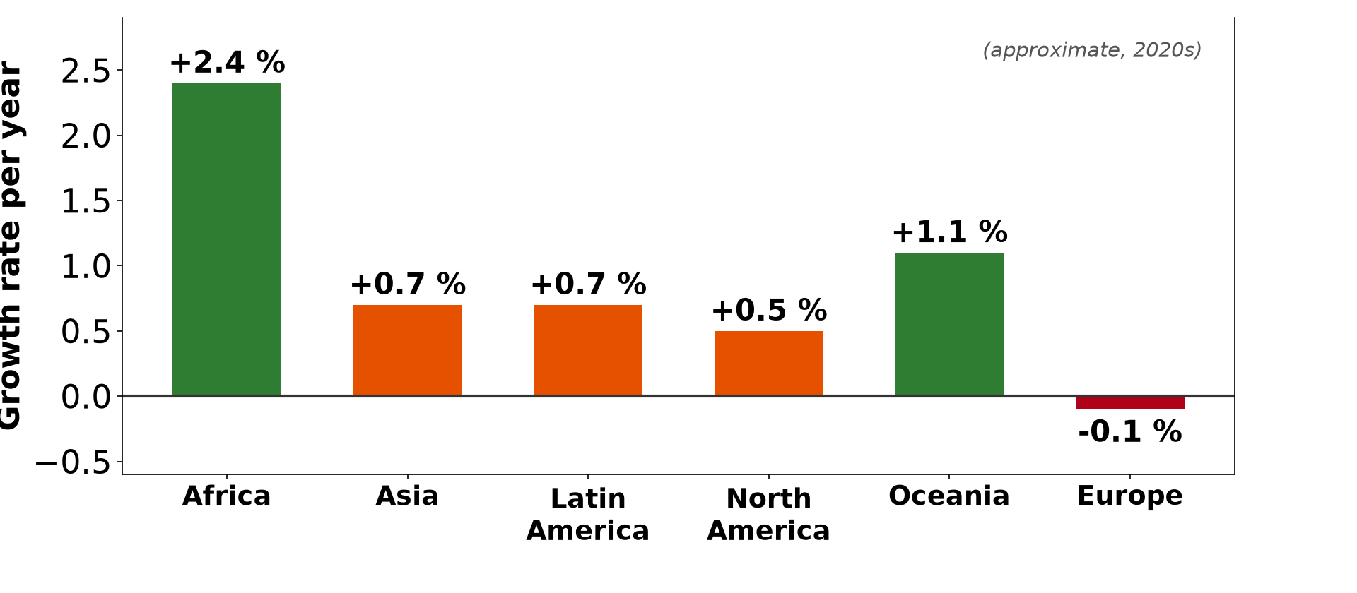
1. DIFFERENTIAL GROWTH RATES
Activity 1
Growth rates by continent (approximate).
Notes:
Activity 1. Look carefully at this diagram: growth rates by continent (approximate). Observe every detail before I ask the question.

Slide 20
1. DIFFERENTIAL GROWTH RATES
Activity 1: Question
Which continent grows fastest? Which is almost not growing?
Notes:
Here is the question for Activity 1: Which continent grows fastest? Which is almost not growing? Take one minute to think and write your answer in your rough notebook.

Slide 21
1. DIFFERENTIAL GROWTH RATES
Activity 1: Answer
Africa (about 2.4 %); Europe (about −0.1 %).
Notes:
Let us check the answer together. Africa (about 2.4 %); Europe (about −0.1 %).

Slide 22
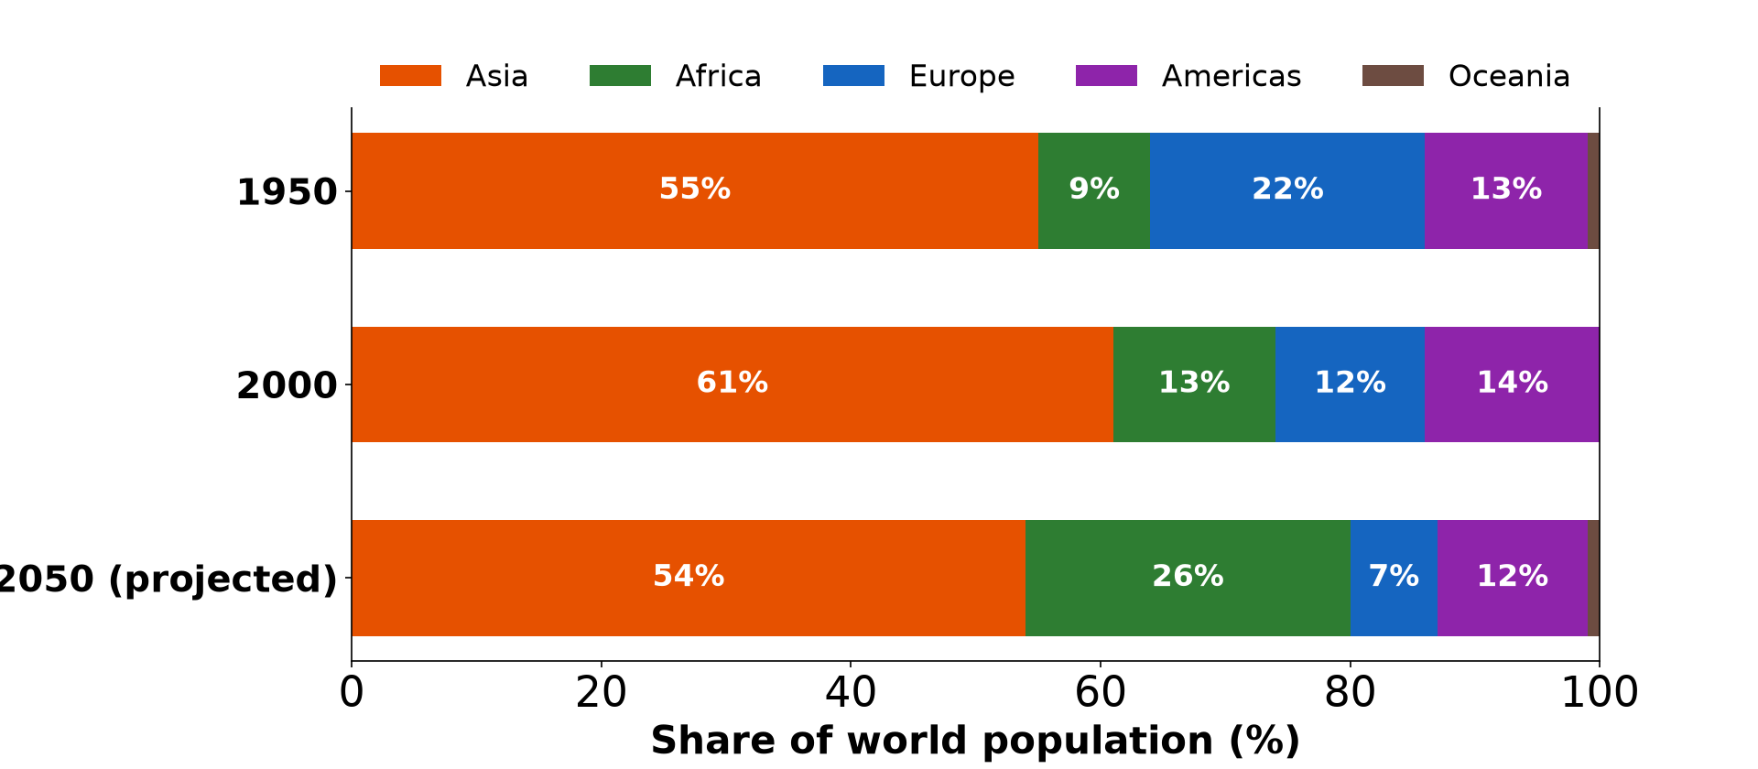
1. DIFFERENTIAL GROWTH RATES
Activity 2
Share of world population 1950–2050.
Notes:
Activity 2. Look carefully at this diagram: share of world population 1950–2050. Observe every detail before I ask the question.

Slide 23
1. DIFFERENTIAL GROWTH RATES
Activity 2: Question
How will Africa's share change from 1950 to 2050?
Notes:
Here is the question for Activity 2: How will Africa's share change from 1950 to 2050? Take one minute to think and write your answer in your rough notebook.

Slide 24
1. DIFFERENTIAL GROWTH RATES
Activity 2: Answer
It will rise from about 9 % to about 26 %.
Notes:
Let us check the answer together. It will rise from about 9 % to about 26 %.

Slide 25

2. MIGRATION
Activity 3
Travellers at a bus station (Wadi Halfa, Sudan).
Notes:
Activity 3. Look carefully at this picture: travellers at a bus station (Wadi Halfa, Sudan). Observe every detail before I ask the question.

Slide 26
2. MIGRATION
Activity 3: Question
How does migration change distribution?
Notes:
Here is the question for Activity 3: How does migration change distribution? Take one minute to think and write your answer in your rough notebook.

Slide 27
2. MIGRATION
Activity 3: Answer
It moves people from source areas to destination areas.
Notes:
Let us check the answer together. It moves people from source areas to destination areas.

Slide 28

2. MIGRATION: RURAL–URBAN
Activity 4
Douala, a fast-growing city.
Notes:
Activity 4. Look carefully at this picture: douala, a fast-growing city. Observe every detail before I ask the question.

Slide 29
2. MIGRATION: RURAL–URBAN
Activity 4: Question
Why is the share of Cameroonians living in towns increasing?
Notes:
Here is the question for Activity 4: Why is the share of Cameroonians living in towns increasing? Take one minute to think and write your answer in your rough notebook.

Slide 30
2. MIGRATION: RURAL–URBAN
Activity 4: Answer
Rural-urban migration and natural increase in towns.
Notes:
Let us check the answer together. Rural-urban migration and natural increase in towns.

Slide 31

2. MIGRATION: FORCED
Activity 5
Refugees in a camp in Chad.
Notes:
Activity 5. Look carefully at this picture: refugees in a camp in Chad. Observe every detail before I ask the question.

Slide 32
2. MIGRATION: FORCED
Activity 5: Question
How can conflict change population distribution?
Notes:
Here is the question for Activity 5: How can conflict change population distribution? Take one minute to think and write your answer in your rough notebook.

Slide 33
2. MIGRATION: FORCED
Activity 5: Answer
People flee to safer areas or other countries.
Notes:
Let us check the answer together. People flee to safer areas or other countries.

Slide 34
BOARD SUMMARY
Board Summary
Topic: Population Numbers
Sub-topic: Population Density and Distribution
Lesson 4: Modifications of Population Distribution
Notes:
Now we are going to copy the board summary. Write the title and the headings neatly in your notebooks. I will give you enough time for each slide, so do not rush.

Slide 35
BOARD SUMMARY
DEFINITIONS
The key terms of this lesson are defined as follows:
Differential growth: It is the difference in population growth rates between regions or countries.
Notes:
Let us copy the definitions. The key terms of this lesson are defined as follows. On this slide we have Differential growth. Write each point on a new line, with the key term first, and explain it in your own words when we revise. When you finish, we go to the next slide.

Slide 36
BOARD SUMMARY
DEFINITIONS (continued)
Redistribution: It is the change in the spatial distribution of population over time.
Notes:
We continue with the definitions. On this slide we have Redistribution. Write each point on a new line, with the key term first, and explain it in your own words when we revise.

Slide 37
BOARD SUMMARY
1. Effects of Differential Growth Rates
Different growth rates change the world distribution:
Fast-growing regions: Africa grows at about 2.5 % a year, so its share of the world population is rising. It may hold a quarter of humanity by 2050.
Notes:
Let us copy Effects of Differential Growth Rates. Different growth rates change the world distribution. On this slide we have Fast-growing regions. Write each point on a new line, with the key term first, and explain it in your own words when we revise. When you finish, we go to the next slide.

Slide 38
BOARD SUMMARY
1. Effects of Differential Growth Rates (continued)
Slow-growing regions: Europe and Japan grow very slowly or decline. Their share of the world population is falling.
Notes:
We continue with Effects of Differential Growth Rates. On this slide we have Slow-growing regions. Write each point on a new line, with the key term first, and explain it in your own words when we revise.

Slide 39
BOARD SUMMARY
1. Effects of Differential Growth Rates
Illustration: share of world population by continent
Notes:
Now draw this illustration in your notebook: share of world population by continent. Give it a title and label it clearly.

Slide 40
BOARD SUMMARY
2. Migration as a Factor of Redistribution
Migration redistributes population as follows:
Rural–urban migration: Young people move from villages to towns for jobs and education. It concentrates population in cities such as Douala and Yaoundé.
Notes:
Let us copy Migration as a Factor of Redistribution. Migration redistributes population as follows. On this slide we have Rural–urban migration. Write each point on a new line, with the key term first, and explain it in your own words when we revise. When you finish, we go to the next slide.

Slide 41
BOARD SUMMARY
2. Migration as a Factor of Redistribution (continued)
International migration: People move from poor to rich countries, for example from Africa to Europe. This increases population in destination countries.
Notes:
We continue with Migration as a Factor of Redistribution. On this slide we have International migration. Write each point on a new line, with the key term first, and explain it in your own words when we revise. When you finish, we go to the next slide.

Slide 42
BOARD SUMMARY
2. Migration as a Factor of Redistribution (continued)
Forced migration: Conflicts and disasters force people to flee, as in the Far North and the North-West and South-West regions. Refugee camps create new concentrations.
Notes:
We continue with Migration as a Factor of Redistribution. On this slide we have Forced migration. Write each point on a new line, with the key term first, and explain it in your own words when we revise.

Slide 43
FORMATIVE EVALUATION
Evaluation 1
How do different growth rates change world distribution?
Notes:
Now let us check what you have understood. Question 1: How do different growth rates change world distribution? Answer in your exercise book.

Slide 44
FORMATIVE EVALUATION
Expected Answer
Faster-growing regions increase their share of the world population.
Notes:
The expected answer is: faster-growing regions increase their share of the world population. If you got it right, well done.

Slide 45
FORMATIVE EVALUATION
Evaluation 2
Give two types of migration that redistribute people.
Notes:
Now let us check what you have understood. Question 2: Give two types of migration that redistribute people. Answer in your exercise book.

Slide 46
FORMATIVE EVALUATION
Expected Answer
Rural-urban migration and international migration (also forced migration).
Notes:
The expected answer is: rural-urban migration and international migration (also forced migration). If you got it right, well done.

Slide 47
REMEDIATION
Remediation
Fill in the blanks:
The fastest-growing continent is ______.
Movement from villages to towns is ______ migration.
People fleeing war are ______.
Notes:
For those who need more practice, fill in the blanks in your exercise book. The answers are: number 1, Africa; number 2, rural-urban; number 3, refugees.

Slide 48
HOMEWORK
Homework
Interview an adult who moved to your town. Write why they came.
Notes:
For your homework: Interview an adult who moved to your town. Write why they came. We shall correct it at the beginning of our next lesson.

Slide 49
NEXT LESSON
Next Lesson
Our next lesson will be on:
Lesson 5: Population Structure
Notes:
Our next lesson will be on Lesson 5: Population Structure. Thank you for your attention, and see you next time.

Slide 50
BILINGUAL GAME
Bilingual Game (Jeu Bilingue)
English | Français
Growth rate | Le taux de croissance
Share | La part
Refugee | Le réfugié
Town | La ville
Village | Le village
Redistribution | La redistribution
Notes:
Let us play the bilingual game. I say a word in English, and you give me the French word. Then we do the reverse.

Slide 51
LOGBOOK
Official Logbook (1/2)
Module / Topic | Population Numbers
Lesson Title | Lesson 4: Modifications of Population Distribution
Expected Learning Outcomes | Explain how different growth rates change world distribution. Explain how migration redistributes people. Give examples of redistribution in Cameroon.
Competence | Learners are able to explain how population distribution changes over time.
Notes:
I record this information in the official logbook of the class after the lesson.

Slide 52
LOGBOOK
Official Logbook (2/2)
Matter Taught | DEFINITIONS; Effects of Differential Growth Rates; Migration as a Factor of Redistribution.
Evaluation | Formative evaluation and remediation exercise.
Homework | Interview an adult who moved to your town. Write why they came.
Enrolment / Present / Absent | ____ / ____ / ____
Achievement | To be completed after the lesson.
Notes:
I complete the second page of the logbook: the matter taught, the evaluation, the homework and the attendance.

Slide 53
TEACHER'S NOTE
Teacher's Note
Timing: Homework correction, plan, objectives 8 min | Recall, situation, action 10 min | 5 activities 30 min | Board summary (copying) 30 min | Evaluation, remediation 10 min | Homework, next lesson 5 min | Logbook 7 min
Without the projector (Activity 1): draw the bars.
Without the projector (Activity 2): read the bars.
Without the projector (Activity 3): ask where relatives have moved.
Without the projector (Activity 4): compare village and town growth.
Without the projector (Activity 5): mention refugees in the Far North and East.
Notes:
This slide is for me, the teacher: it gives the timing of the lesson and what to do if the projector is not available.

Slide 54
REFERENCES
References
National Geography Syllabus, MINESEC/IGE/IP-SS, 2019 — Module 4 (Population Geography).
Photo, Activity 3: “Wadi Halfa Bus Station” by D-Stanley, CC BY 2.0, via Flickr (https://www.flickr.com/photos/79721788@N00/8651154444)
Photo, Activity 4: “Douala” by christing-O-, CC BY 2.0, via Flickr (https://www.flickr.com/photos/76187282@N00/7227535754)
Photo, Activity 5: “Secretary-General Visits Refugee Camps in Chad” by United Nations Photo, CC BY-NC-ND 2.0, via Flickr (https://www.flickr.com/photos/35483578@N03/6140060599)
Diagrams and animations: drawn for this lesson (Geography Department).
Notes:
These are the references and picture credits used to prepare this lesson.

